Slide 1
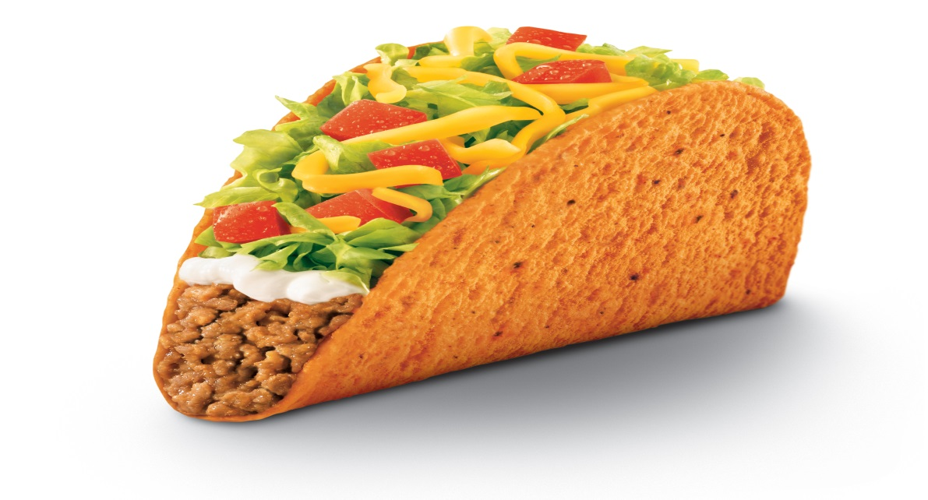
Attendance Challenge

Slide 2
Rewards
We are asking all students from WOHS to attend school everyday and earn rewards for meeting this challenge.

Slide 3
Graduate For Mas Challenge

Slide 4
Registration
Counselors will begin registering students next week by conducting classroom guidance during an advisory period.

Slide 5
Parent Letters
Please take the letter home to your parents. Any student that does not want to participate will need to return a signed letter by February 9, 2015

Slide 6
Winners!!!
Just sign-up and you will be an instant winner. A taco bell coupon will be received immediately.

Slide 7
Additional Community Resources to Assist Drop-Out Prevention
Handouts:
Local Food Pantries, Clothing & Assistance in Onslow County
Onslow County Community Health Resource Guide
Department of Social Services Program Fact Sheet
Adolescent Parenting Program Referral
Emergency Food Supply 2009
Health Check Dentists
CCC Dental Clinic
Eye Doctors
Translators Who Work for Non-Profit Agencies

