Slide 2
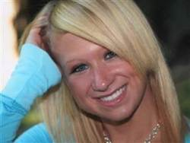
Jessica Logan
18 year old
In a committed relationship and sent her boyfriend “some pictures”
After the relationship end…the pictures were shared.
She was then harassed, being called a slut and a whore.
She was miserable and depressed, afraid even to go to school.
Eventually, she hung herself in her bedroom closet.

Slide 3
Hope Witsell
13 years old
Sexting a picture of her breasts to her boyfriend
Picture ended up going viral to a neighboring 6 schools
Started a “burn book” & a Hope Hater page
Hung herself in her bedroom

Slide 4
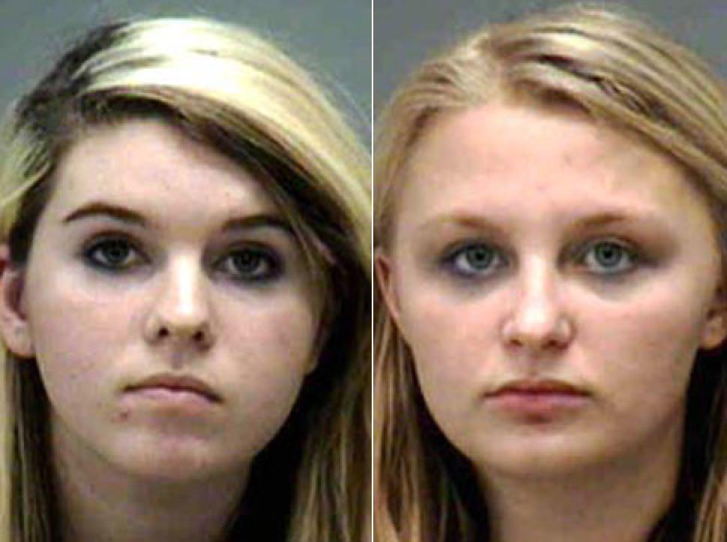
Taylor Wynn & Mckenzie Barker
Taylor Wynn, 16 & McKenzie Barker, 15, charged with cyberstalking
created a Facebook page in the name of a classmate - complete with their classmate's head on a "nude prepubescent girl's body,"
Next to the doctored photo, the girls added the comment "I am a member of the Itty Bitty Titty Comitty!! <3 (sic).“
Another picture on the fake Facebook page showed the victim's head with her mouth opened next to an adult male's erect penis,
Two weeks later, the sheriff received information that another Facebook account was created of the victim, with similar art.
While the girls claimed it was all just in good fun, the victim didn't quite see it that way.
Even while facing charges, the alleged bullies seemed to have no regrets.
When asked by her mother, in front of police, what would possess her to do such a thing, Wynn reportedly replied, "Because nobody liked her."

Slide 5
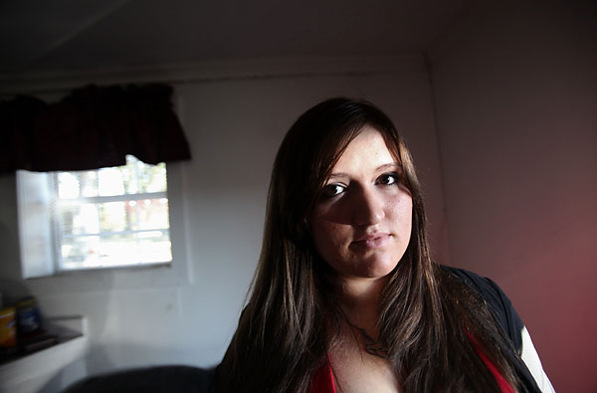
Michelle Edwards
High school senior suspended after posting on a friend’s FB wall
After making a 93 on a English essay…The teacher called part of it "incoherent," and the friend was upset, so Edwards said she commiserated.
"I say we shoot our english teacher in the face," she posted on the friend's wall. "But then again we might not be able to carry that out since we're so incoherent.“
Another teacher saw it & reported it.
Edwards was thinking about attending Tidewater Community College next year, possibly to study design. She's also thought about becoming a teacher. That could all change, she said, if she gets expelled.
"With this, there's no telling what will happen now."

Slide 6
Ashley Payne
With a pint of beer in one hand and a glass of wine in the other,
the worst thing you could accuse Ashley Payne of is mixing her drink.
But this happy holiday picture has cost the high school teacher her job after a parent spotted it on Facebook - and complained.
The picture was taken while travelling around Europe in the summer of 2009.
But Miss Payne, 24, was shocked when she was summoned to the principal's office at Apalachee High School, in Winder, Georgia, and offered an ultimatum.
She told CBS News: 'He just asked me, "Do you have a Facebook page?"
'And you know, I'm confused as to why I am being asked this, but I said, "Yes", and he said, "Do you have any pictures of yourself up there with alcohol?"'
He then offered her an option: resign or be suspended.
She chose to resign.
- See more at: http://www.georgianewsday.com/news/61845-teacher-ashley-payne-fired-for-posting-picture-of-herself-holding-beer-on-facebook.html#sthash.rayB9OBI.dpuf

Slide 7
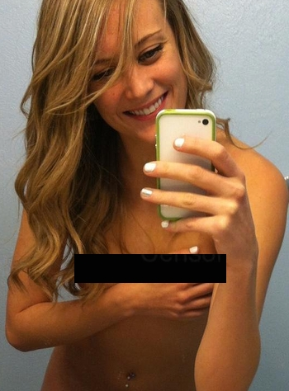
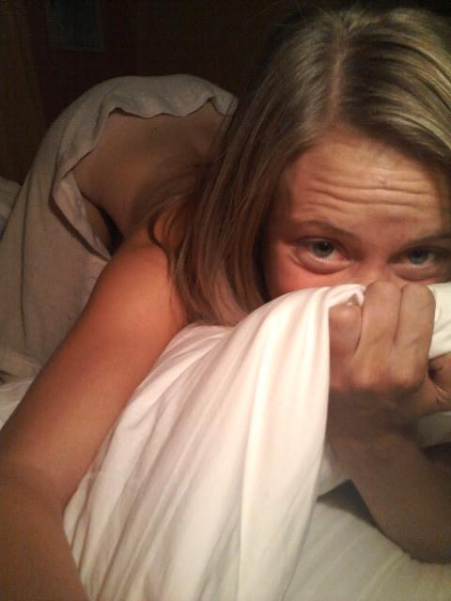
Carly McKinney aka.CrunkBear
Overland High teacher Carly McKinney made international headlines after being suspended in the wake of tweets featuring NSFW photos and jokes about drugs.
She insisted that someone with access to the account had posted items without her say-so, including photos like this one....
…and this one…
also featured were tweets like "Naked. Wet. Stoned" and "Watching a drug bust go down in the parking lot. It's funny cuz I have weed in my car in the staff parking lot."

Slide 8
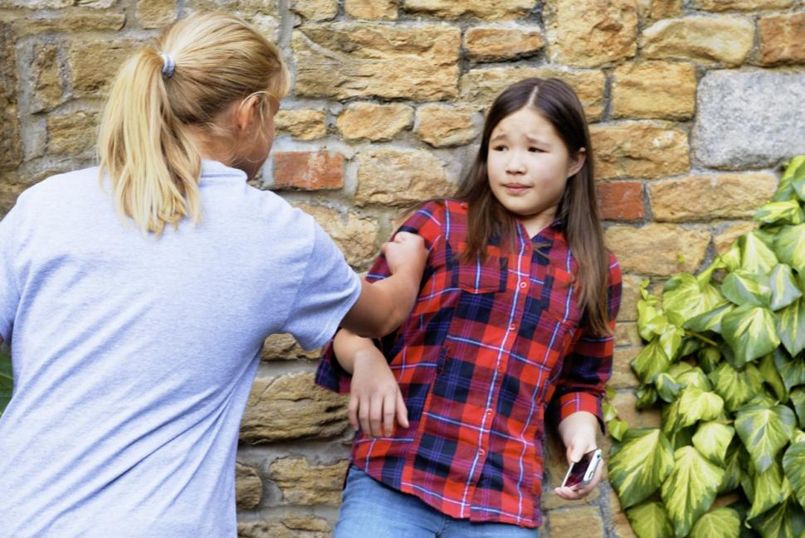
Monona, Wisconsin
Raising a bully in Monona, Wisc., can cost parents a pretty penny.
Police in the town are now holding parents liable for failing to address their kids' bad behavior. Bullying fines start at $114 and repeat offenses can cost parents up to $177 every time.
The new municipal ordinance is a response to an uptick in school shootings, teen suicides and cyber bullying. Monona Police Chief Walter Ostrenga believes that solutions to this "global" problem start at home. He's hoping that the citations will push parents to take responsibility for their children's actions.

