Slide 1
#Disengagement #Steps for Families & Schools to Stop Bullying/Cyberbullying

Slide 2
Charges
Assault
Stalking
Sexual Harassment
Domestic Violence
Defamation of Character
Child Pornography

Slide 3
#Takeaways

Slide 4
What to do on our campuses?
“Awareness without action is a successful lawsuit waiting to happen.”
~ Mary Jo McGraft

Slide 5
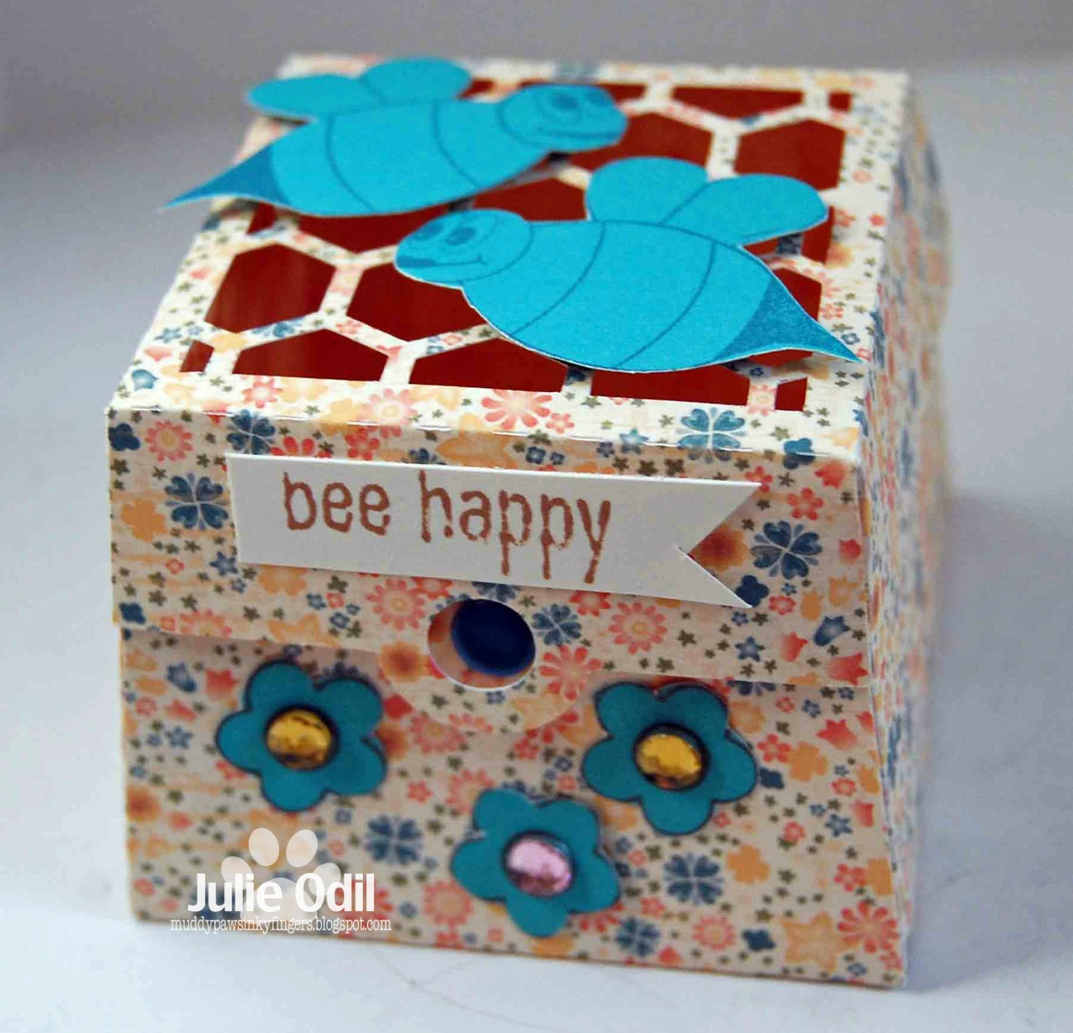
Substitution strategies
Marking skin
Wearing rubber bands
Rubbing ice
Putting hands in cold water
BUTTERFLY PROJECT
The HAPPY Box

Slide 6
Things to consider when informing parents/Guardians of Student Self-harm and/or Ideation
Inform student of disclosure
Prepare students for parent reaction
Have as much information as possible before contacting parent
Assess prior knowledge of self-harm
Be mindful of cultural considerations
Provide recommendations based on risk of harm

Slide 7
Video
https://www.youtube.com/watch?v=fhBXlVTNZsg
https://www.youtube.com/watch?v=fhXlVTNZsg

Slide 8
If perception is reality then we must work to change our reality…
“The process of change should be not a thunderstorm on a barren island, but a gentle rain over time.”

