Slide 1
Creeping with Caution: How to Slither through Halloween Safely!
Edited By Mr. D

Slide 2
Or
Trick or treat game
Place the following under the correct heading
Is it a Trick – FALSE
Is it a Treat - TRUE

Slide 9
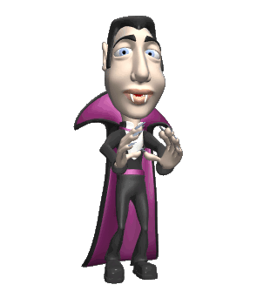
It’s that time of year once again. Time to don your creepiest costume and slink through your neighborhoods.
Let’s learn some safety rules to ensure your happy haunting this Hallow’s Eve.

Slide 10
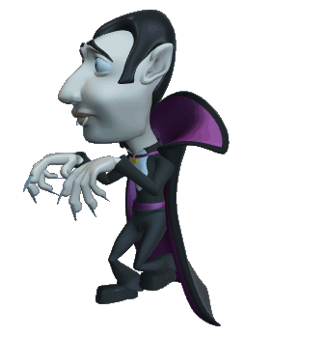
Planning your Fright Night
Before you go out, plan your trip, and let your adult know where you’re going.
Check in with your adult by cell phone during your evening.
Set a time for returning home, and stick to it!

Slide 11
Haunting in Your ‘Hood
NEVER go out alone!
Do not go into anyone’s home OR car!
Walk in groups and bring a responsible adult or older person.

Slide 12
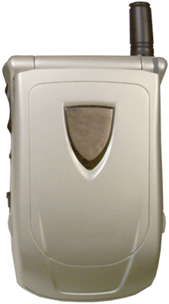
What to Bring with You
A flashlight
A cell phone
A whistle
A super big bag for goodies!

Slide 13
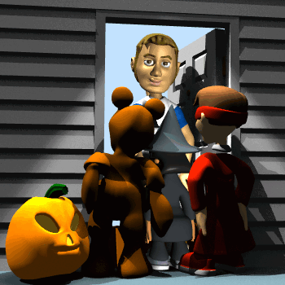
Slithering from House to House
Go to houses that have lights on or Halloween decorations.
Be careful around jack o’ lanterns and cords to decorations.

Slide 14
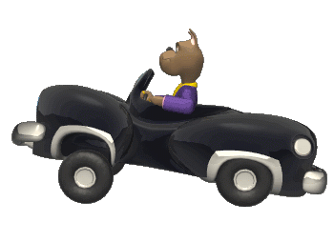
Beware of Ghosts
AND Cars!
Don’t take short cuts through alleys or fields!
Look both ways when crossing the street.
Walk only on the sidewalks.
Take little ones’ hands.

Slide 15
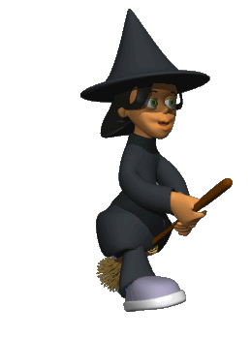
Spooking in Style
If you have a dark costume, wear a glowstick or a necklace, and put reflective tape on your back.
Wear comfortable shoes: ones you can walk and run in.
If you’ve got a mask, take it off while walking and crossing the street.

Slide 16
No Tricks with Treats
Wait until you get home to eat any candy. Have someone check it out for you!
Throw away any candy with open wrappers.

Slide 17
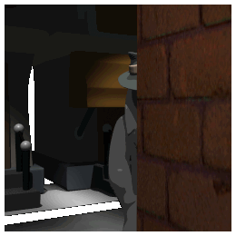
Stranger Safety
Do not go anywhere with a stranger! PERIOD!
If you are lost, find an adult with another group of tricksters, and ask for help.
If someone stops you to ask for help, SCREAM and RUN to where people are!

Slide 18
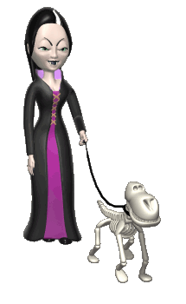
Important Last Words
Be a good goblin.
Don’t be cruel.
Vandalism is never cool.
Be kind to people and animals!

Slide 19
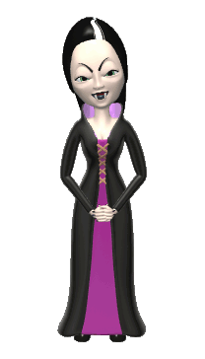
Halloween Safety
http://www.youtube.com/watch?v=Q7ce9xECyj8
Click above
for some
Halloween Safety
tips

Slide 20
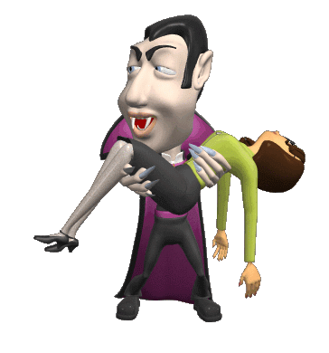
Ready to Haunt?
See if you can pass this
True or False quiz.
It’s to DIE FOR!

Slide 21
True or False? Click the letter to choose your answer.
It is easy for drivers to see trick or treaters in the dark.
T
F

Slide 22
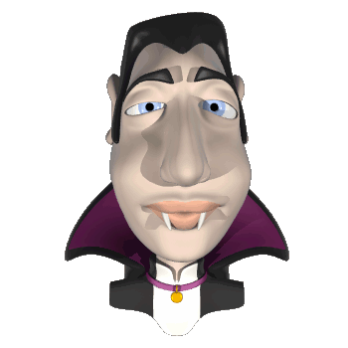
Yes, that IS correct!

Slide 23
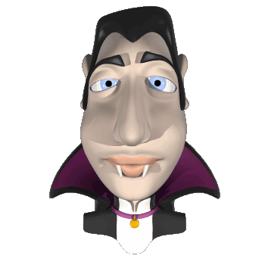
Nay, this is untrue!

Slide 24
True or False?
You should have an adult check your candy before eating it.
T
F

Slide 25
Right you are!

Slide 26
Bad blood, wrong answer!

Slide 27
True or False?
Never go anywhere with a stranger.
T
F

Slide 28
Absolutely!

Slide 29
Wrong, I’ve tricked you!

Slide 30
True or False?
Only little kids need to be safe while trick or treating.
T
F

Slide 31
Wow, you’re incredible!

Slide 32
Sorry…tis wrong!

Slide 33
True or False?
You’re going to have a safe and “SPOOKTACULAR”
Halloween!
T
F

Slide 34
Of course you will!
Happy Halloween!

Slide 35
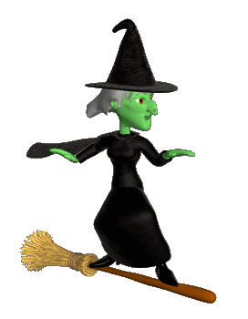
Wishing you a safe and
Happy Halloween!
From Mr. “D”
Next slide

Slide 36
Halloween Safety Game online
Click below to play the game
If you dare
http://www.halloweenmagazine.com/play.html

Slide 37
Get a Halloween Safety Mini Book from Mr. D

