Slide 1
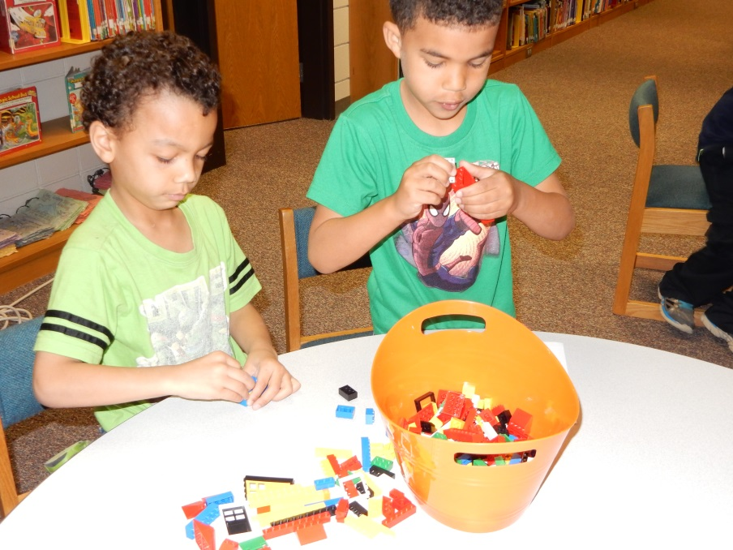
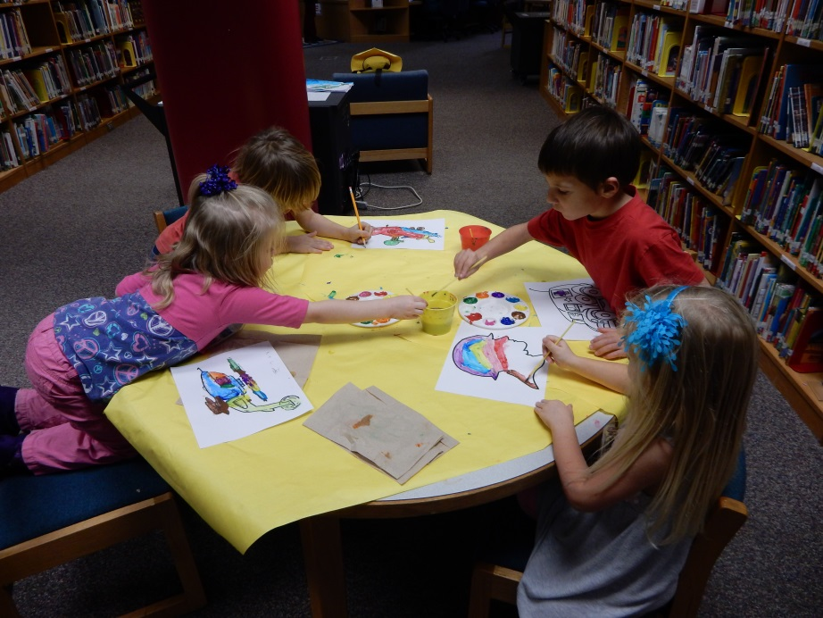
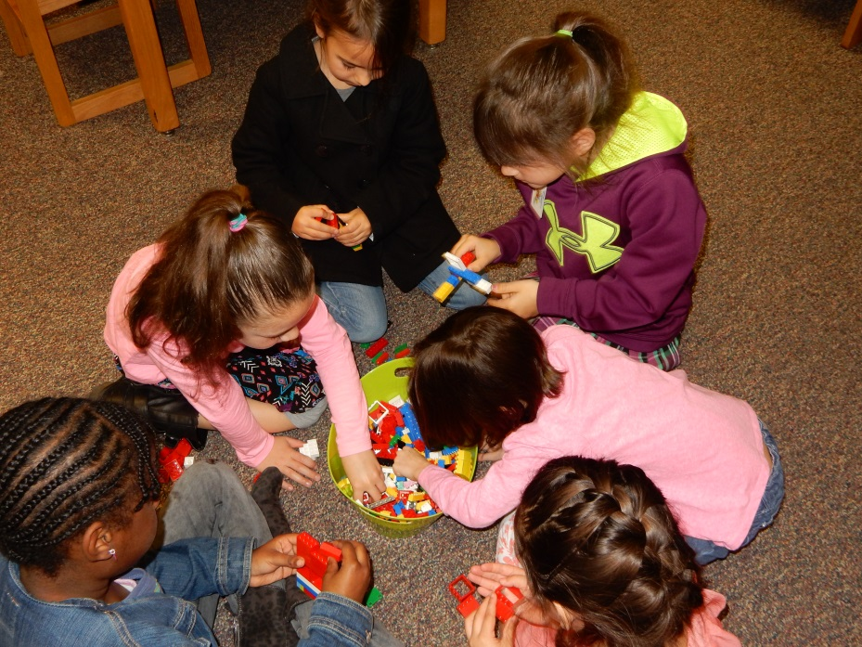
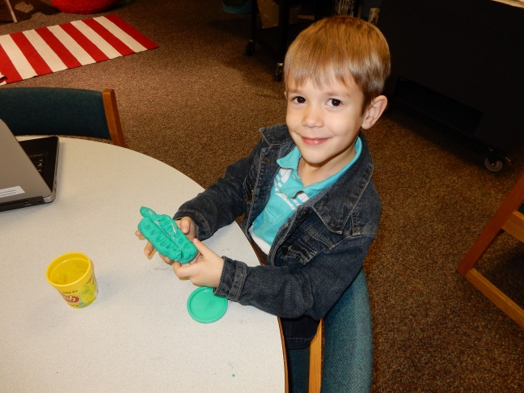
Small Groups
Primary & Elementary

Slide 2
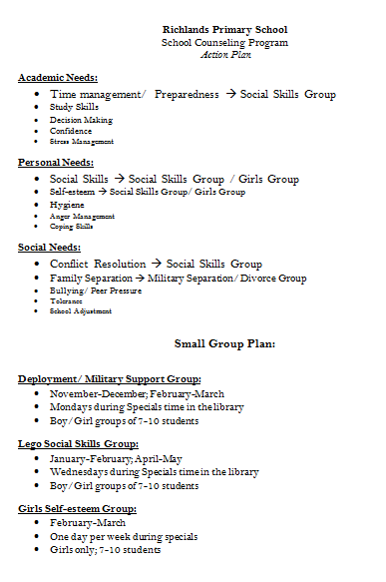
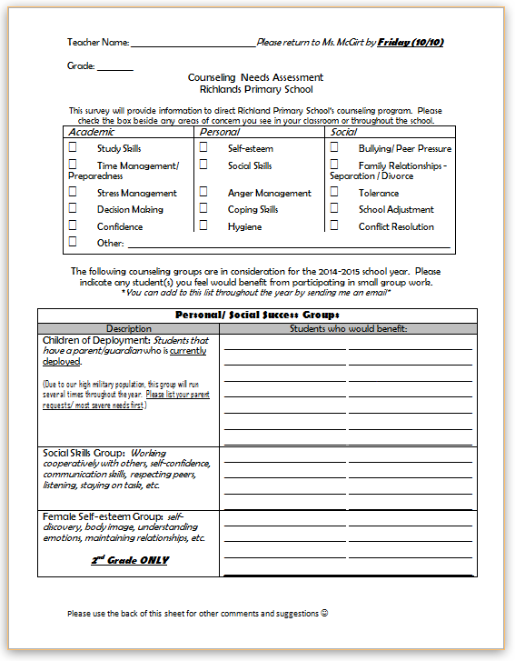
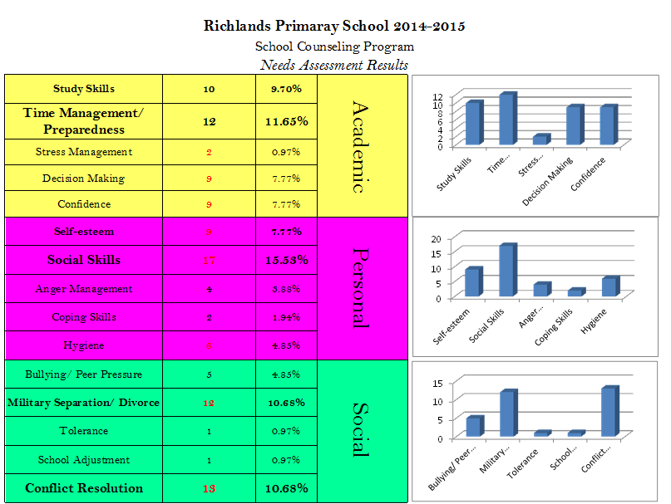
Planning and Schedules
BOY Needs Assessment for Teachers

Slide 3
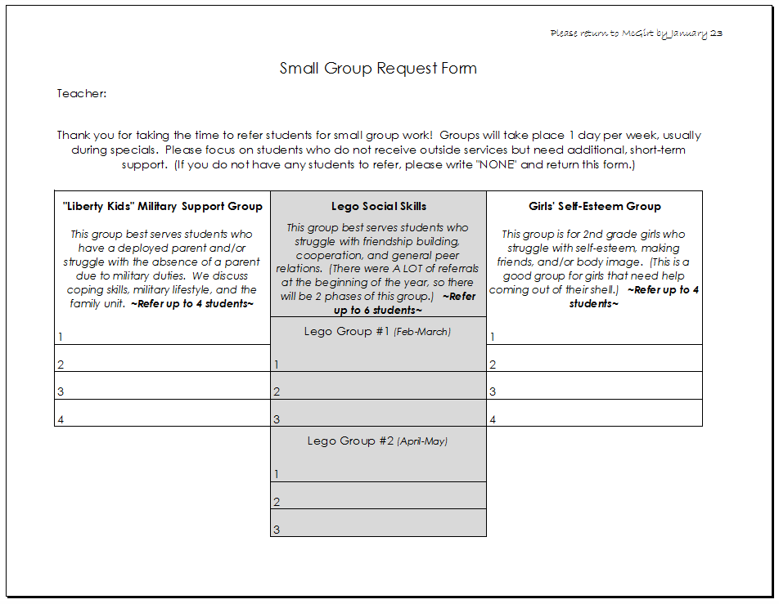
Planning and Schedules
Teacher referrals / Parent referrals

Slide 4
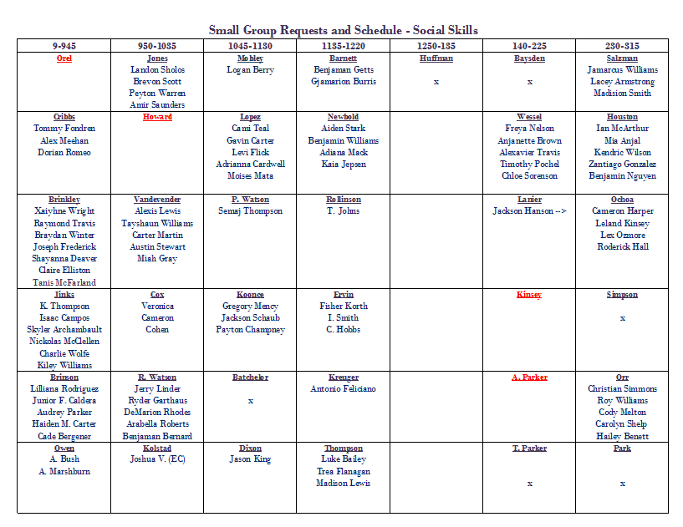
Planning and Schedules
Teacher Buy-In
Pulled during specials time (A-F day rotation)
Groups of 8-10
50 Minutes
Mix of boys and girls

Slide 5
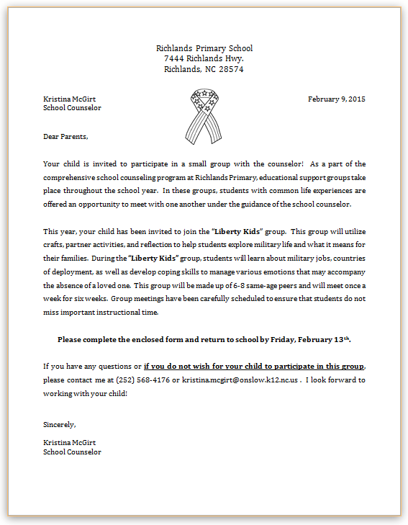
Military Support Group
“Liberty Kids”
Deployed / Separated / Affiliated
Parent Letter

Slide 6
Military Support Group
Activities
At the beginning of each group:
Group rules: What we say here, stays here
Purpose of the group
Family Updates
Military Knowledge:
“Hero”
Discuss buzz words: military, deployment, etc.
Learn branches of service (ground, sea, air)
Military uniforms
Jobs
Feeling Knowledge:
Emotions with (pre-/post-) deployment
Communication & what to do when you can’t
What to do when you feel lonely
Helping at home

Slide 7
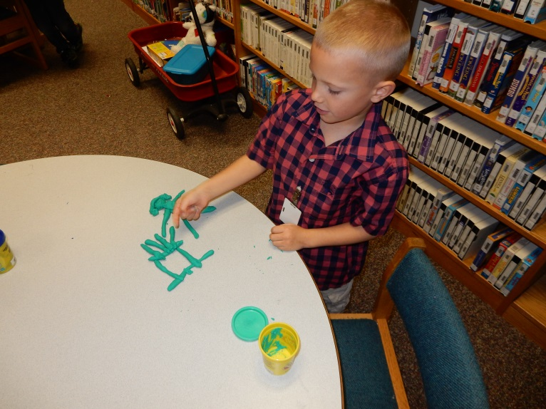
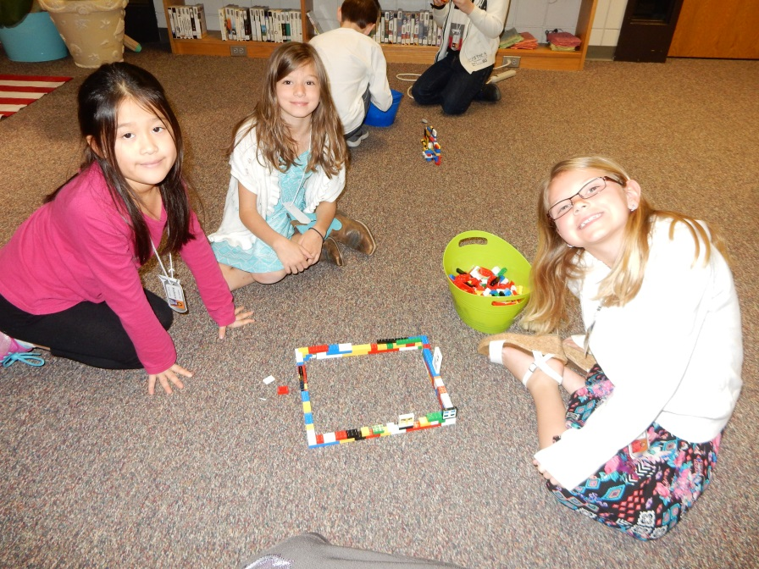
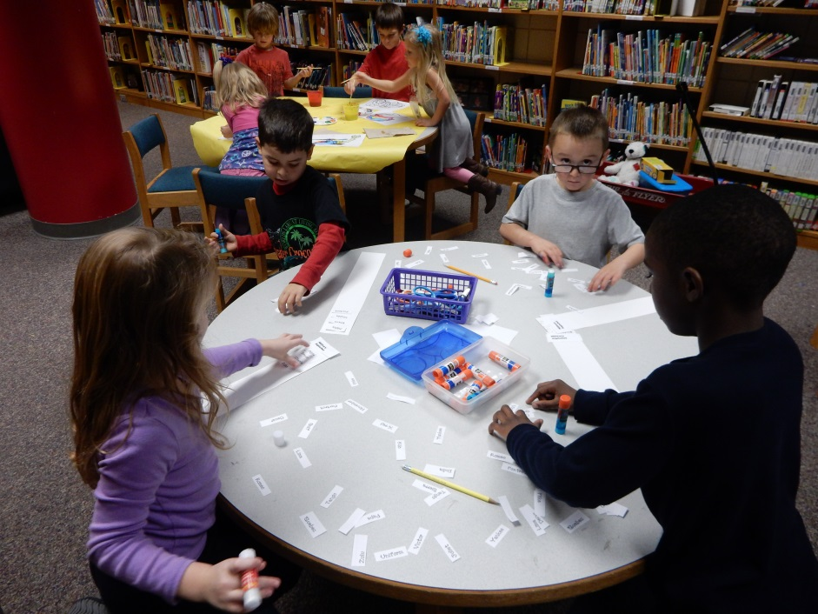
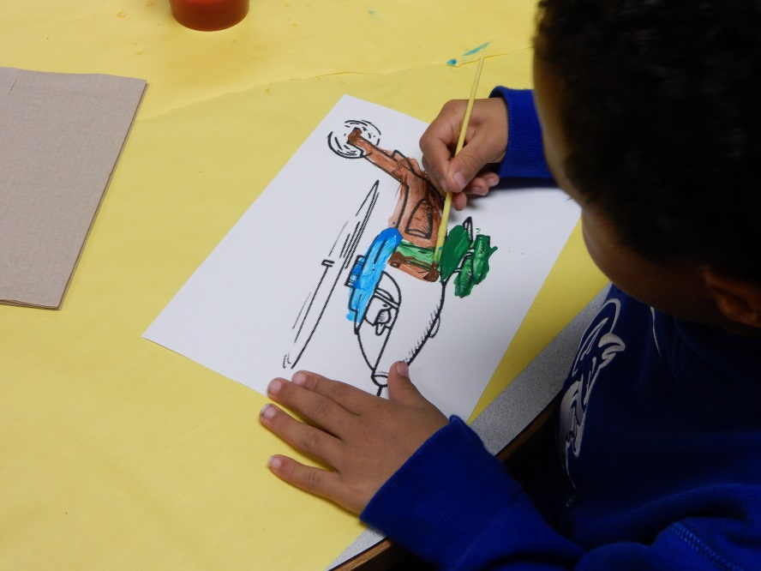
Military Support Group
Activities

Slide 8
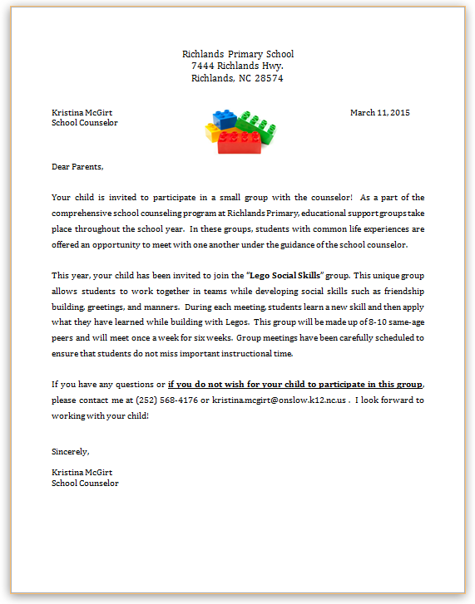
Social Skills Group
“Lego Group”
Students who struggle making friends/ social cues/ following directions/ listening
Parent Letter

Slide 9
Social Skills Group
Activities
At the beginning of each group:
Feelings Chart (check-in/ check-out)
Points cup on each table
Part 1:Learn something new
Greetings & Manners (Role Play)
Conversation
Sharing
Following directions (“Slime” & Deck of cards)
Stress & Anger (“It bugs me when…”)
Patience
Part 2: Build to Practice and Share
Theme days: tallest tower, bugs, racecar, animals, etc.
Manners, sharing, & positive reinforcement earn coins → coins earn extra time at the end

Slide 10
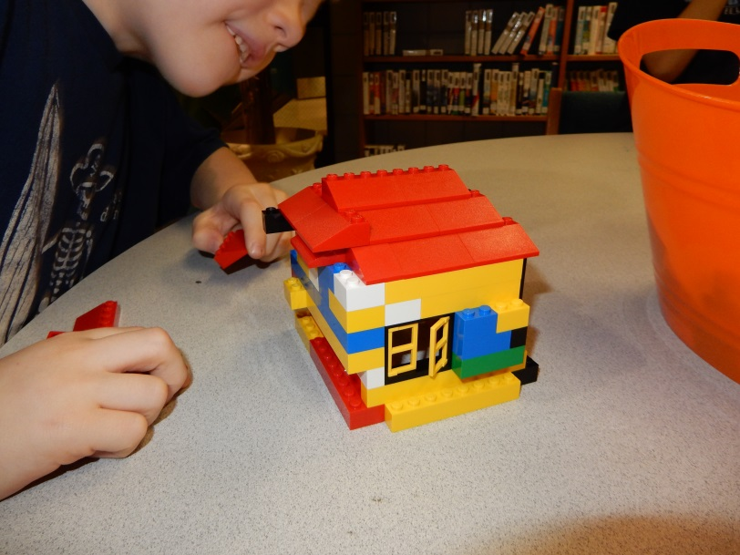
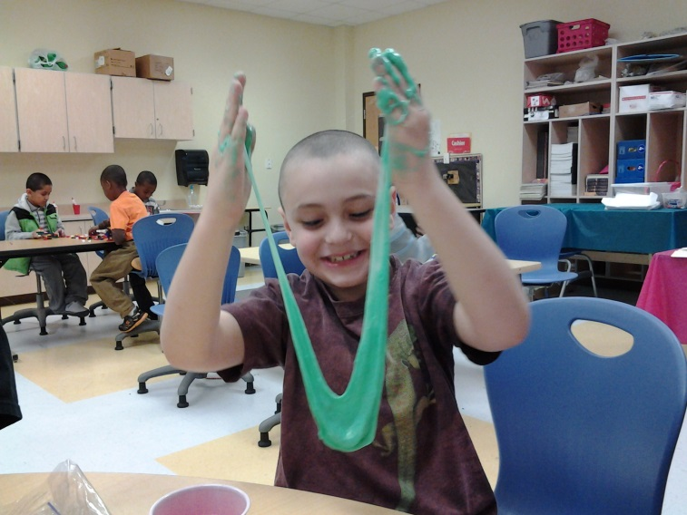
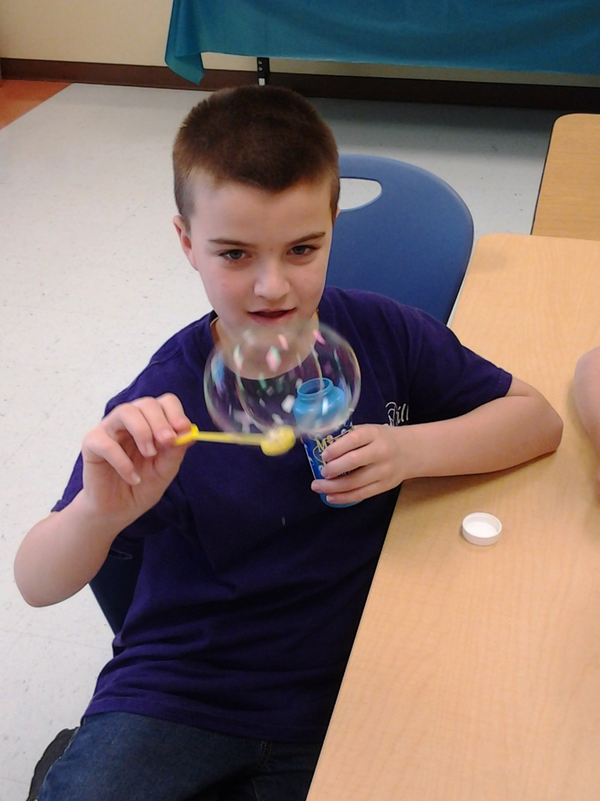
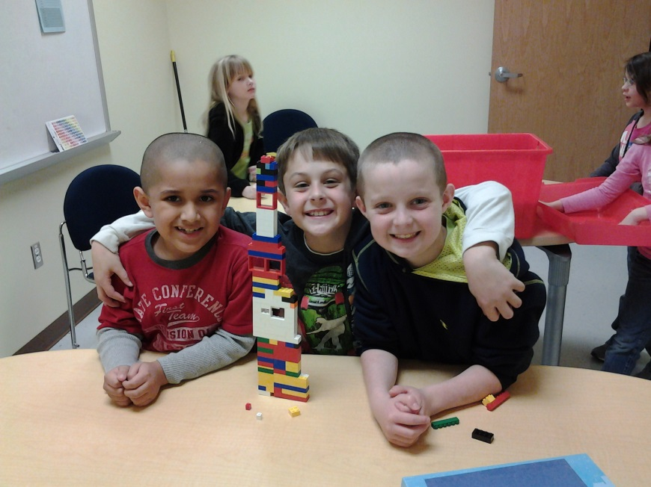
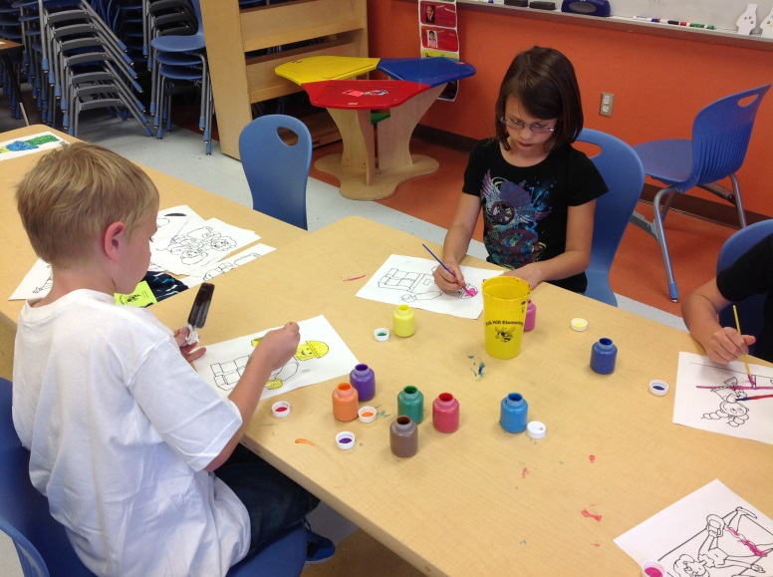
Social Skills Group
Activities

