Slide 1
Student Advocate
Survey
By Mr. D
K – 2nd grade - click here

Slide 2
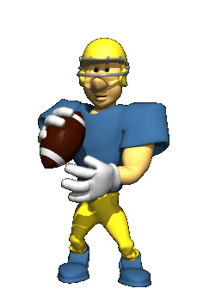
Get a card from Mr. D
Put your first and last name on the card
Put today’s date on the card (at the top)
Write your teacher’s name on the side of the card.

Slide 3
We all need an adult who we can count on and trust!
Every child deserves a champion: an adult who will never give up on them, who understands the power of connection and insists that the child become the best he or she can possibly be. - Rita Pierson
An adult to support them

Slide 4
Today we are asking you to identify one adult here at school that you feel is {an advocate for you} or {my supporter} or {someone who I can go to if I have a question or problem}.

Slide 5
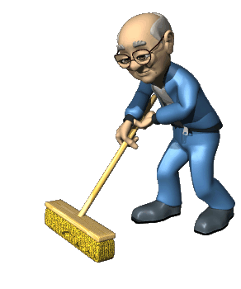
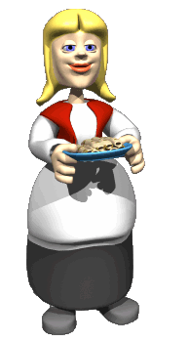
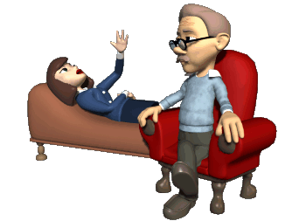
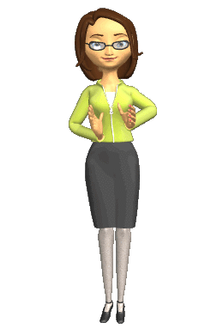
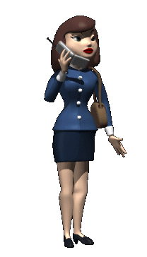
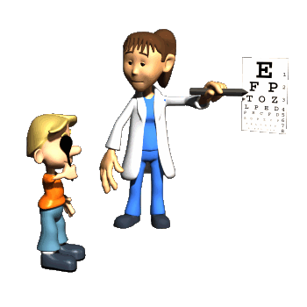
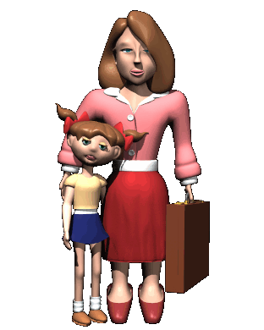
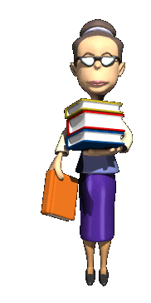
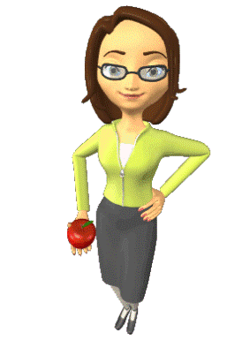
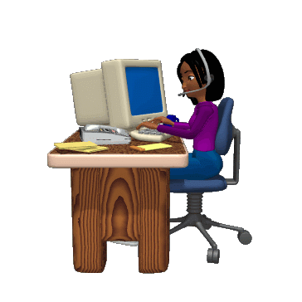
Some of the people that support us at school are:
Counselor
Custodian
Lunch Lady
Bus Driver
Nurse
Teacher
Principal
Teacher
Assistant
Assistant
Principal
Librarian
Secretary

Slide 6
Draw a circle around the person who helps you the most at school. K-2 only
Counselor
Custodian
Lunch Lady
Bus Driver
Nurse
Teacher
Principal
Teacher
Assistant
Assistant
Principal
Librarian
Secretary

Slide 7
I feel _________ is my advocate. This person is someone who supports me and is someone who I can go to for advice or encouragement.
Counselor
Custodian
Lunch Lady
Bus Driver
Nurse
Teacher
Principal
Teacher
Assistant
Assistant
Principal
Librarian
Secretary

Slide 8
There may be someone else (another adult) at the school who is your advocate
Write the Name of Your Advocate
If you DO NOT feel that you have an advocate at the school ☹ please place an X on the last line.
Mr. D & I Thank you for
participating in our Advocate Survey

