Slide 1
Tech Tools to Reflect: Global Competency and Service Learning
Susanne Long
Brent Anderson

Slide 2
Agenda
Project-Based Inquiry (APDR) Model
Overview of K-12 Service Learning Standards
K-12 Service Learning Cards/Overview
Tech Tools to Reflect: Implementing the Ask, Plan, Do, Reflect model

Slide 3
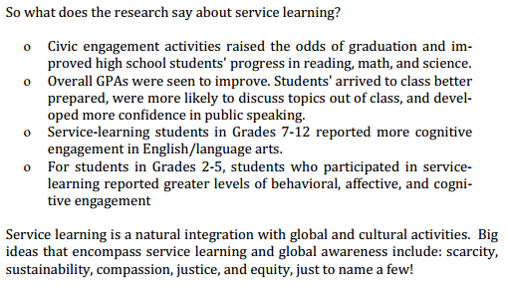
Research about service learning…

Slide 4
Service Learning and Common Core
Demonstrate literacy with a variety of texts-As students investigate an issue, they use a variety of communication tools
Applying learning to new situations, especially real-world contexts-By definition, service-learning challenges students to demonstrate academic literacy through application in new situations, to solve and to carry out real world application
Knowledge and skills for success in college and career
Engaging students in critical thinking and problem solving

Slide 5
K-12 Service Learning Standards

Slide 6
Resources and Connections…
http://billmoyers.com/content/slideshow-poverty-in-todays-america/
http://www.worldhunger.org/us_hunger_pictures.htm
Connections to concept-based instruction global lens
Connections to graduation projects

Slide 7
Ask, Plan, Do, Reflect (APDR) Model
Ask
Plan
Do
Reflect

Slide 8
K-12 Service Learning Standards
Meaningful Service (Ask)
Link to Curriculum (Plan)
Reflection (Reflect)
Diversity (Plan)
Youth Voice (Do)
Partnerships (Ask)
Progress Monitoring (Do)
Duration and Intensity (Reflect)

Slide 9
Tech Tools – Ask
Ask – Meaningful Service, Partnerships
Socrative
QR Codes
Padlet
Pinterest
Learnist-Educational form of Pinterest
Google Forms
Survey Monkey

Slide 10
Tech Tools – Plan
Plan – Diversity, Link to Curriculum
Edmodo
Edublog-Secure blog created for education Supports student and teacher learning through reflection, questioning and collaboration
Ning-Online platform for creating communities
OpenStudy-Create online study/collaborative groups
ePals-Collaborative cross-cultural learning exchanges
Donors Choose
Co-Creation-An online platform to co-create

Slide 11
Tech Tools – Do
Do – Progress Monitoring, Youth Voice
Twitter
Smore-Online Flyers to spread the word
Wordle
Google Docs
Edmodo
Capzles-Create rich interactive online stories or timelines

Slide 12
K-12 Service Learning Standards
Meaningful Service (Ask)
Link to Curriculum (Plan)
Reflection (Reflect)
Diversity (Plan)
Youth Voice (Do)
Partnerships (Ask)
Progress Monitoring (Do)
Duration and Intensity (Reflect)

Slide 13
Tech Tools – Reflect
Reflect– Reflection, Duration and Intensity
Evernote
Dropbox
TodaysMeet
Edublog-Secure blog created for education. Supports student and teacher learning through reflection, questioning and collaboration & Edublogger, a blog that helps Edubloggers
Klablab-online forum to meet and share, especially performing arts/music (currently in BETA mode)

