Slide 1
Using Data in Your School Counseling Program
Stacey Endicott RES School Counselor 20 February 2015

Slide 2
Our Evaluation States…
Standard 1: School counselors demonstrate leadership, advocacy, and collaboration.
Standard 1a: …School counselors take an active role in analyzing local, state, and national data to develop and enhance school counseling programs. School counselors create data-driven goals and strategies that align with the school improvement plan to improve student learning…
Standard 1c: School counselors advocate for positive change in policies and practices affecting student learning…

Slide 3
NC Evaluation continued
Standard 2: School counselors promote a respectful environment for a diverse population of students.
Standard 2d: …School counselors recognize that all students have different needs and collaborate with school and community personnel to help meet their needs. School counselors identify these needs using data, referrals, observation, and other sources of information.

Slide 4
NC Evaluation continued
Standard 3: School counselors understand and facilitate the implementation of a comprehensive school counseling program.
Standard 3d: School counselors use data to develop comprehensive programs that meet student needs. School counselors deliberately, strategically, and broadly incorporate into their programs the life skills that students need to be successful in the twenty-first century. These skills span the academic, personal/social, and career domains and include leadership, ethics, accountability, adaptability, personal productivity, personal responsibility, people skills, self-direction, and social responsibility.

Slide 5
NC Evaluation continued
Standard 4: School counselors promote learning for all students.
Standard 4b: School counselors use academic, behavior, and attendance data to plan appropriate programs for students.
Standard 4c: School counselors utilize the Guidance Curriculum, Individual Student Planning, and Preventive and Responsive Services in meeting the needs of students as they strive to raise achievement and close gaps. School counselors spend the majority of their time in these direct services, allocating time based on the developmental needs of their students.

Slide 6
NC Evaluation continued
Standard 5: School counselors actively reflect on their practice.
Standard 5a: …School counselors analyze student achievement, behavior, and school climate data, as well as feedback from students, parents, and other stakeholders to continually develop their program. School counselors evaluate the effectiveness of their program based on these data.

Slide 7
The use of data is interwoven into every aspect of our comprehensive school counseling program and evaluation instrument

Slide 8
Accountability Data and Actively Reflecting on our Practice

Slide 9
Time Analysis
Microsoft Outlook
Color Coded Calendar
Under Categorize, you will be able to create your own color categories
Yellow—Administrative duties
Red—Classroom Core Curriculum
Teal—Consultation/Collaboration
Black –Non-Counseling Fair Share Duties
Gray –Individual Counseling
Purple—Parent/Guardian/Agency Contact
Dark Blue—Professional Development
Green—Small Group Counseling
Light Blue—Team Meetings (504, II, IEP, etc.)
Orange--Testing

Slide 10
Time Analysis
Microsoft Excel
EZ Analyze
Free download at http://www.ezanalyze.com/
Must enter email address and agree to licensing
Microsoft Excel add-in

Slide 11
So…how do these tools work together?
First, you must keep track of what you’re doing/how you are spending your time in your Outlook Calendar.
I usually plug in what I know I am doing first (classes, duty, meetings, etc.) and fill in the rest as I go/when I can, sometimes writing minimal details/times on a post-it
What I do put in the calendar is very basic, to avoid issues in the future

Slide 12
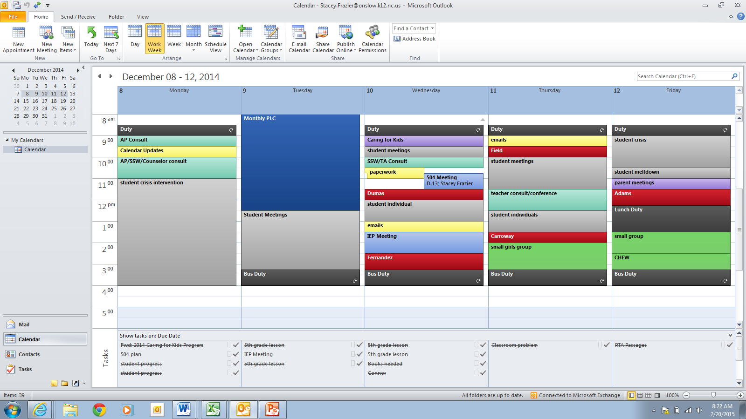

Slide 13
So...how do these tools work together?
At the end of the month, once you have your time allotted for and the colors put in, the next step is to export your calendar into an Excel document
File
Options
Advanced
Export to a File
Microsoft Excel
Name the Calendar (Month Time Analysis)
Choose Date Range (I use first and last day of the month)

Slide 14
So…how do these tools work together?
Open the Microsoft Excel document you just created
You will see a chart that will need some modification
Add in a new column in column F named “Elapsed Time”
Create the formula to fill down column f for the elapsed time
=(E2-C2)*24
Make sure that all of column G says “False,” or else you will get skewed results

Slide 15
Completing Your Time Analysis
Click Add-Ins at the top of your Excel Document
Choose EZ Analyze
Pick the Graph Option
Choose the Disaggregation Graph
Your Dependent Variable will be Elapsed Time
Your Categorical Variable will be Categories
The Statistic Reported will be Sum of Dependent Variable
Keep it with Bar Graph (we will change it on the next screen)

Slide 16
Completing Your Time Analysis
Under ‘Chart Tools,’ choose ‘Change Chart Type’
Change to Pie Graph
Under ‘Chart Tools,’ choose ‘Data Labels’
Check ‘Category Name,’ ‘Value,’ ‘Percentage,’ and ‘Show Leader Lines’
Use ‘Best Fit’ for Label Position

Slide 17
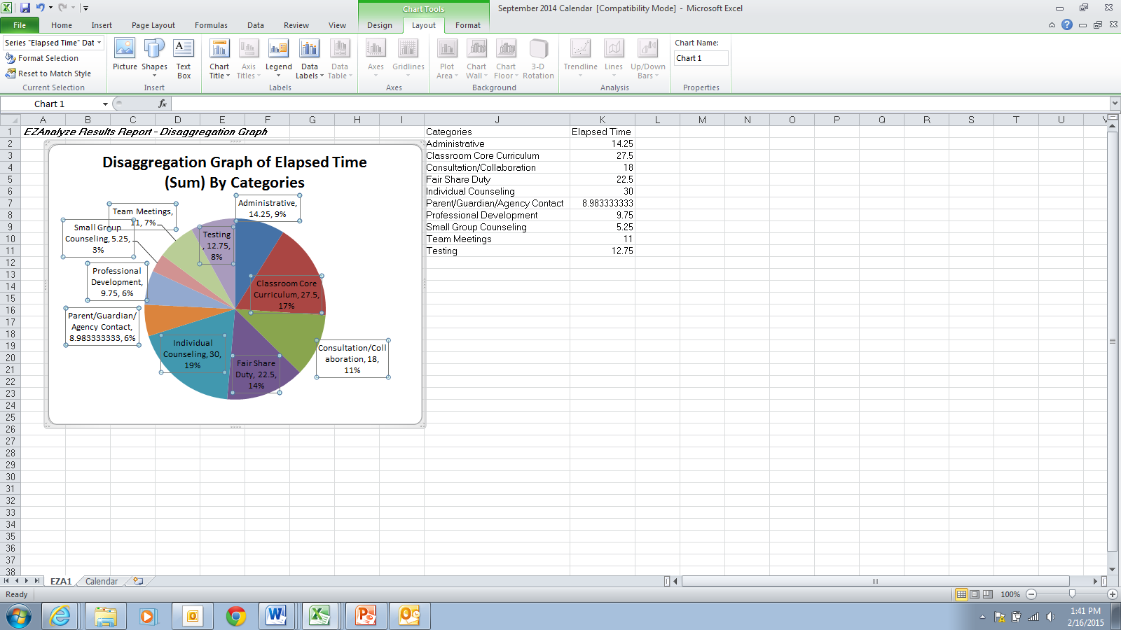

Slide 18
Looking at Your Data
Are you close to or have you exceeded 80/20?
Are you spending or did you spend more time doing something non-counseling related?
Are there ways that you could improve upon how you are spending your time?
Are you able to advocate for/against doing something because you have actual data in hand showing the need?
How can you tweak what you are doing next month/next year?
How can you incorporate this data into your comprehensive counseling program?

